Slide 1

Reconocimiento de Patrones
Domingo Mery
Departmento de Ciencia de la Computación
Escuela de Ingeniería
Universidad Católica de Chile
Semestre 2018-1
Accuracy Estimation (Problems)
[ Capítulo 5 ]

Slide 2

On Accuracy Estimation in Face Biometric Problems
Domingo Mery, Yuning Zhao and Kevin Bowyer

Slide 3
Motivation

Slide 4
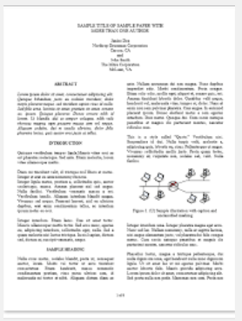
If we read in a paper on face expression recognition…
The accuracy obtained by the proposed method was 97.3%
We could believe that 97.3% of the expressions that a person makes will be correctly recognized.

Slide 5
If we read in a paper on face expression recognition…
The accuracy obtained by the proposed method was 97.3%
We could believe that 97.3% of the expressions that a person makes will be correctly recognized.
However,
how confident is this value for the dataset used in the paper?
how generalizable is the proposed method for a wider variety of conditions?
can this 97.3% be compared with the 98.5% reported in another paper for expression recognition experiments on the same dataset?

Slide 6
WHAT?
Typically we focus on the “what” elements of the dataset.

Slide 7
WHAT?
What is the number of images in the dataset?
>> Larger is better.
What kinds of expressions were taken into account?
>> A greater variety is generally better.
What are the illumination conditions in the images?
>> A broader range is generally better.
What is the gender, age and racial sampling of the data?
>> Greater balance on these dimensions is generally better.
Such questions are good and important, although many papers are published without such properties of the dataset being detailed.

Slide 8
WHAT?
Typically we focus on the “what” elements of the dataset.
HOW?
Nevertheless, the generalizability issue should also raise questions about “how” the images are used to estimate accuracy, as well as “what” is represented in the images.

Slide 9
How is the accuracy estimated?
>> Mean? weighted mean?
How is the experimental protocol defined?
>>Leave-one-out? Half-Half? 10-fold cross-validation?
How are the images divided into train and test portions?
>> Randomly? Every N-th image?
>> According to time of acquisition?
How is the data sampled from the underlying original data collection?
>> Is any data that was originally collected not used?
>> If so, is this documented?
How is the person-specific nature of the data captured?
>>Are train and test splits person-disjoint?
How is the variance in the estimated accuracy estimated?
>> High? Low?
HOW?

Slide 10
A real example about ‘how’…

Slide 11
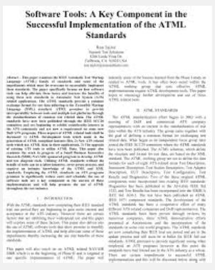

The images were divided into ten subsets. For each validation fold, nine subsets were used for training purposes and the remaining subset was used for testing. This step was repeated ten times, and the accuracy of the ten folds were averaged to compute the final estimation of the accuracy. The classification rate was 96.3%.
A
The subjects used for training were not used for testing. We have used a 10-fold cross validation procedure. The estimated accuracy was 70.0%
B
We divide 10 facial expression sequences of every person into training and testing sets. Firstly, we use one expression image for testing, others for training. Then 14 images are used for training and 7 images left for testing. At last 7 images are used for training and 14 images for testing. The recognition rate can reach about 95.0%.
C
Notes:
At first, we may think that method [A] is better than [B] and [C] because it has the highest reported accuracy. Nevertheless, method [C] uses such an uncommon way to evaluate the accuracy that probably no other reported method can be directly compared with [C] due to the difference in experimental protocols. In addition, we might be tempted to think that the 96.3\% in [A] and the 70.0\% in [B] could be used in a fair comparison because both protocols use cross-validation with 10 folds. However, paper [A] is silent about how the `subsets' are defined. Thus it is very difficult to establish if, for this accuracy estimate, the subjects whose images appear in one of the ten subsets also have images in the other nine subsets. Probably, in protocol [A], a given subject has some images that appear in the training set and other images that appear in the testing set. These details are very important in face expression recognition because the recognition is easier if we are trying to recognize the expression of a subject that was used in the training set. Now, we can understand why method [B] has an accuracy estimate of `only' 70.0\%. The protocol used is more realistic because subjects that appear in the training set do not appear in the testing set. The accuracy estimate in this case has a much better chance of holding up in the face of new data. In conclusion, we can say that in this example that accuracies of [A], [B] and [C] are not comparable because the experimental protocols are too radically different.

Slide 12
Typical Problems
There are two typical problems in “how” the images were used in the experiments:
no standard protocol, and
ill-defined protocols.
They undermine the research on biometrics because they lead to confusing differences in strength of protocol with differences in estimated accuracy of algorithms.

Slide 13
We propose the ‘EPD Methodology’…
E - Experiments
Wherever a subject-disjoint train-and-test split would be possible, it should be used.
P - Protocol
The protocol should ideally be to report the mean and standard deviation of some number of randomized 10-fold cross validation trials.
Reviewers should accept accuracy reported on a single hold out trial only if there is a clear justification made.
D - Data
Any downsampling from the collected dataset should be described and justified. Wherever possible, results should be presented with and without the downsampling, so that reviewers can judge its effect.

Slide 14
Toy Example

Slide 15
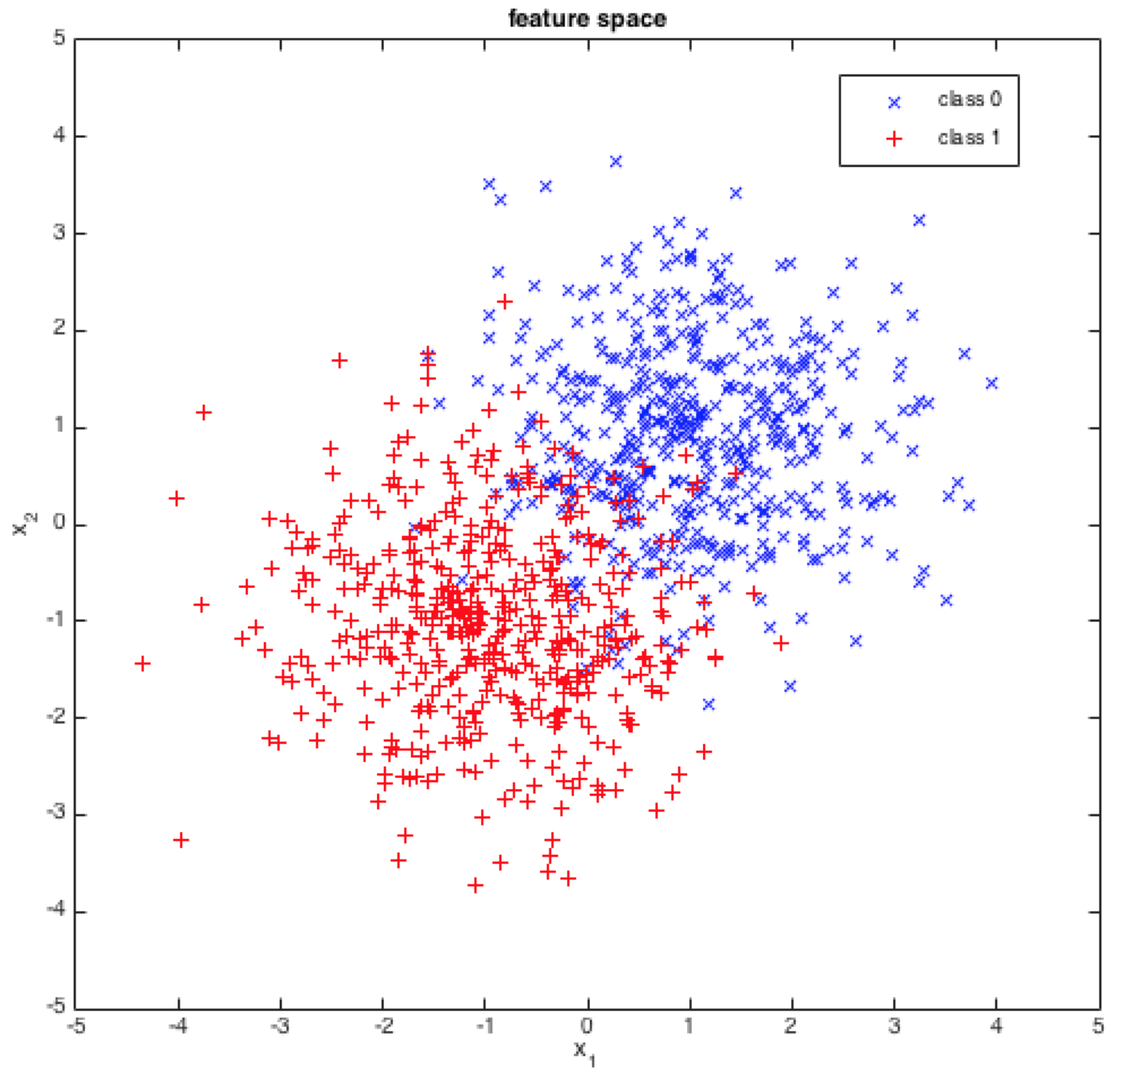
[ SIMULATED DATA ]
2 Classes
2 Gaussian Distributions
μ₁ = (1,1)
μ₂ = (-1,-1)
σ₁ = σ₁ = 1
500 samples /class
N₀ = 1000 (available data)

Slide 16
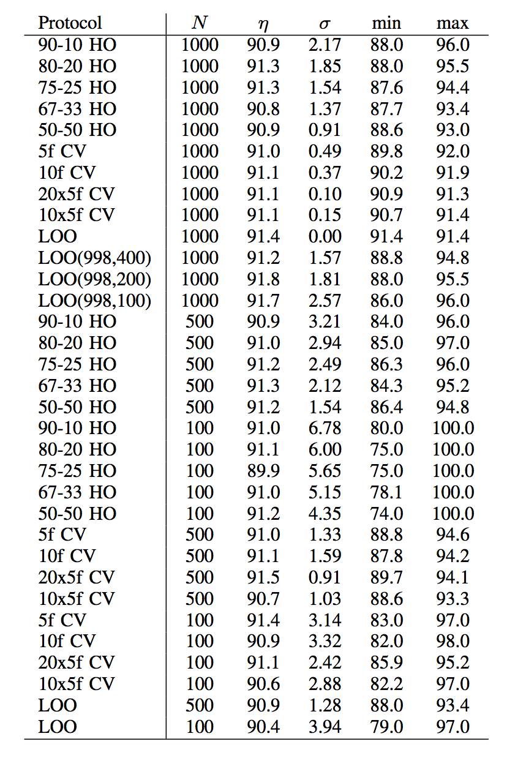
Accuracy Estimation using KNN (K=3) AFTER 50 REPETITIONS
Notes:
As we can see in Table \ref{Tab:ToySVM} and Table \ref{Tab:ToyKNN} the estimated accuracy can vary widely around the true mean value. In Table \ref{Tab:ToySVM}, the mean accuracy over all of the different protocols varies from a low of 91.7\% to a high of 93\%. We can be confident that the true mean value is in this range. However, the range between the minimum and maximum accuracy found with a single instance of a given experimental protocol is much broader. A single trial of 90-10HO can give an accuracy as low as 60\% and as high as 100\%. It is clear that in this example SVM has a better accuracy than KNN. However, the variation of the estimated accuracies does not depend on the classifier, because both classifiers show similar behaviors.
The problem of the variation in the estimate of the accuracy is in how the data was used. By selecting certain samples of the available data (see Fig. \ref{Fig:ToyExample}), it is likely that no sample from the confusion zone is considered in the testing dataset and thus a high accuracy could be estimated. This is the case of hold-out 80-20 with 1000 samples: it is likely to obtain 98\% in same cases (see that the maximal value for SVM 80-20 is 98\%). It is then possible, that the reported accuracy could be 98\% whereas a more realistic value is 92.8\%. For KNN, the same situation can be seen. It can possibly be reported as an accuracy of 96.5\%. However, a better estimation would be 91.1\%. It is worth mentioning, that as we can see in Table \ref{Tab:ToySVM} and Table \ref{Tab:ToyKNN}, high (unrealistic) accuracies can be estimated in cases where both the number of samples or the number of evaluations are reduced. On the one hand, for 80-20 HO, the accuracy is better estimated if we use 1000 samples than 500 or 1000 samples. On the other hand, in 80-20 HO there is only one evaluation of the accuracy (training with 80\% testing with 20\%), a better estimation is obtained by 5f CV where there are 5 evaluations using training with 80\% testing with 20\% (or much better by 20 $\times$ 5f CV with 100 evaluations). In our experiments, the lowest variation of the estimated accuracy ($\sigma \le 0.05\%$) is obtained by LOO and 20$\times$5f CV with 1000 samples.

Slide 17
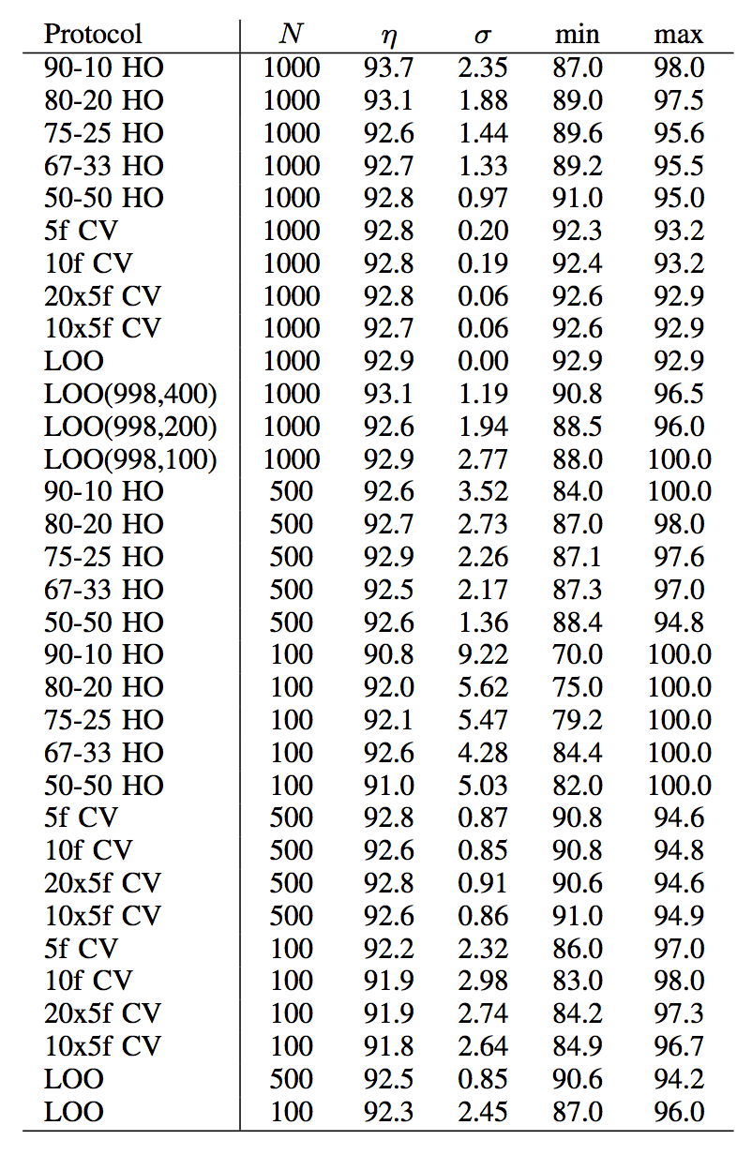
Accuracy Estimation using Linear-SVM AFTER 50 REPETITIONS
Notes:
As we can see in Table \ref{Tab:ToySVM} and Table \ref{Tab:ToyKNN} the estimated accuracy can vary widely around the true mean value. In Table \ref{Tab:ToySVM}, the mean accuracy over all of the different protocols varies from a low of 91.7\% to a high of 93\%. We can be confident that the true mean value is in this range. However, the range between the minimum and maximum accuracy found with a single instance of a given experimental protocol is much broader. A single trial of 90-10HO can give an accuracy as low as 60\% and as high as 100\%. It is clear that in this example SVM has a better accuracy than KNN. However, the variation of the estimated accuracies does not depend on the classifier, because both classifiers show similar behaviors.
The problem of the variation in the estimate of the accuracy is in how the data was used. By selecting certain samples of the available data (see Fig. \ref{Fig:ToyExample}), it is likely that no sample from the confusion zone is considered in the testing dataset and thus a high accuracy could be estimated. This is the case of hold-out 80-20 with 1000 samples: it is likely to obtain 98\% in same cases (see that the maximal value for SVM 80-20 is 98\%). It is then possible, that the reported accuracy could be 98\% whereas a more realistic value is 92.8\%. For KNN, the same situation can be seen. It can possibly be reported as an accuracy of 96.5\%. However, a better estimation would be 91.1\%. It is worth mentioning, that as we can see in Table \ref{Tab:ToySVM} and Table \ref{Tab:ToyKNN}, high (unrealistic) accuracies can be estimated in cases where both the number of samples or the number of evaluations are reduced. On the one hand, for 80-20 HO, the accuracy is better estimated if we use 1000 samples than 500 or 1000 samples. On the other hand, in 80-20 HO there is only one evaluation of the accuracy (training with 80\% testing with 20\%), a better estimation is obtained by 5f CV where there are 5 evaluations using training with 80\% testing with 20\% (or much better by 20 $\times$ 5f CV with 100 evaluations). In our experiments, the lowest variation of the estimated accuracy ($\sigma \le 0.05\%$) is obtained by LOO and 20$\times$5f CV with 1000 samples.

Slide 18
Literature Review

Slide 19
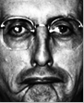
FERET
Gender
Notes:
The FERET database contains more than 3,500 face images from women and men (with different races such as African, Asian and Caucasian) involving different expressions and illumination conditions. In the literature, there are many reported experimental protocols.

Slide 20
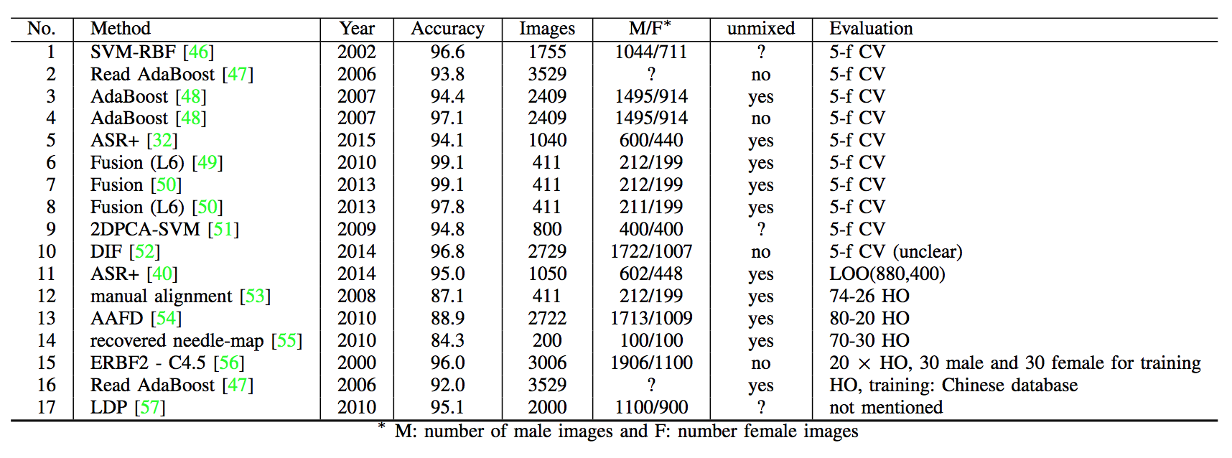
Gender Classification using FERET Dataset
Notes:
The FERET database contains more than 3,500 face images from women and men (with different races such as African, Asian and Caucasian) involving different expressions and illumination conditions. In the literature, there are many reported experimental protocols.
The protocols vary based on different number of images, number of females and males, and `mixed' or `unmixed' datasets.
For the 17 papers on FERET database listed in the Table, there is only 1 instance where a pair of papers used the same train-test protocol, including gender distribution and number of images: lines 6 and 7.

Slide 21
Gender Classification using FERET Dataset
Notes:
The FERET database contains more than 3,500 face images from women and men (with different races such as African, Asian and Caucasian) involving different expressions and illumination conditions. In the literature, there are many reported experimental protocols.
The protocols vary based on different number of images, number of females and males, and `mixed' or `unmixed' datasets.
For the 17 papers on FERET database listed in the Table, there is only 1 instance where a pair of papers used the same train-test protocol, including gender distribution and number of images: lines 6 and 7.

Slide 22
14 papers with 17 gender classification results using the FERET dataset. How many pairs of papers have directly comparable results?
One.

Slide 23
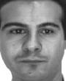
AR
Face Recognition
Notes:
The AR database consists of 26 different images of each of 50 women and 50 men.
The 26 images represent different facial expressions, illumination conditions, and occlusions with sunglasses and scarf.
The number of images per subject is 26. The characteristics of this database (occlusion/no occlusion, facial expressions/neutral, etc.) allow a large number of different experiments.

Slide 24
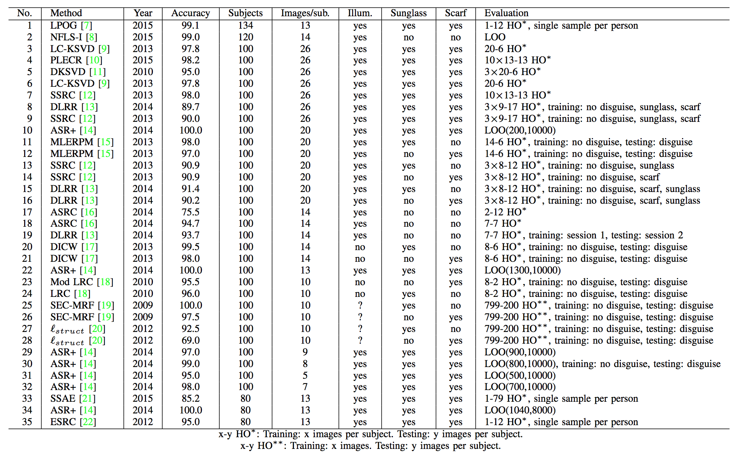
Face recognition using AR Dataset
Notes:
The AR database consists of 26 different images of each of 50 women and 50 men.
The 26 images represent different facial expressions, illumination conditions, and occlusions with sunglasses and scarf.
The number of images per subject is 26. The characteristics of this database (occlusion/no occlusion, facial expressions/neutral, etc.) allow a large number of different experiments. Thus, it is very difficult to make fair comparisons when the protocols are not exactly the same. For the 34 papers on AR database listed in the Table, there appear to be 2 pairs of papers that used effectively the same protocol: 4 and 7, and 8 and 9.

Slide 25
Face recognition using AR Dataset
Notes:
The AR database consists of 26 different images of each of 50 women and 50 men.
The 26 images represent different facial expressions, illumination conditions, and occlusions with sunglasses and scarf.
The number of images per subject is 26. The characteristics of this database (occlusion/no occlusion, facial expressions/neutral, etc.) allow a large number of different experiments. Thus, it is very difficult to make fair comparisons when the protocols are not exactly the same. For the 34 papers on AR database listed in the Table, there appear to be 2 pairs of papers that used effectively the same protocol: 4 and 7, and 8 and 9.

Slide 26
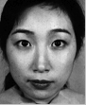
JAFFE
Expressions
Notes:
The JAFFE database contains 7 expressions (`neutral' and six basic emotions: `fear', `happiness', `sadness', `surprise', `anger' and `disgust') captured from 10 Japanese women. For each subject, there are 3--4 face images for the non-neutral and one for the neutral expressions, {\em i.e.}, the database consists of 213 images.

Slide 27
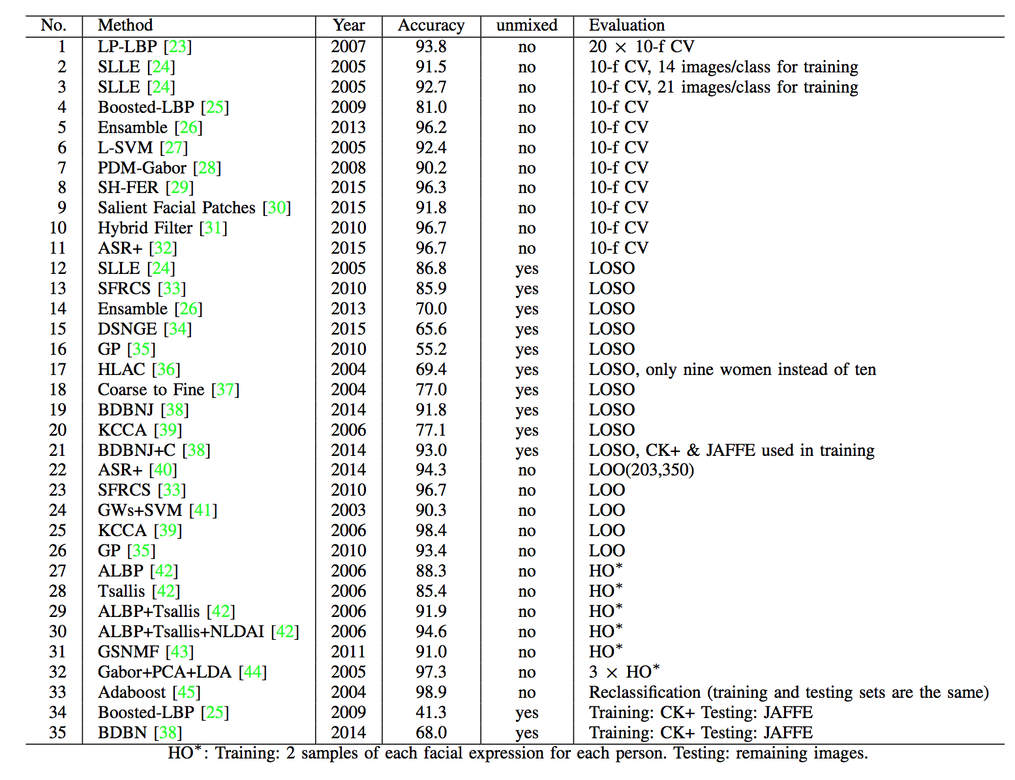
Expression recognition using JAFFE Dataset
Notes:
The JAFFE database contains 7 expressions (`neutral' and six basic emotions: `fear', `happiness', `sadness', `surprise', `anger' and `disgust') captured from 10 Japanese women. For each subject, there are 3--4 face images for the non-neutral and one for the neutral expressions, {\em i.e.}, the database consists of 213 images. There are 35 different publications on the JAFFE database represented in the Table ,and at least 13 different evaluation protocols. As a group, the papers that used the HO and LOO protocols reported the highest estimated accuracies, 88.3\% to 96.7\%. The papers that used some variation of the CV protocol reported the next highest accuracies, 81\% to 96.7\%. And the papers that used some variation of the LOSO protocol reported the lowest accuracies, 55.2\% to 93\%.
Probably the most important single piece of information in the Table is the `unmixed' column, indicating whether the train and test division was person-disjoint.

Slide 28
Expression recognition using JAFFE Dataset
Notes:
The JAFFE database contains 7 expressions (`neutral' and six basic emotions: `fear', `happiness', `sadness', `surprise', `anger' and `disgust') captured from 10 Japanese women. For each subject, there are 3--4 face images for the non-neutral and one for the neutral expressions, {\em i.e.}, the database consists of 213 images. There are 35 different publications on the JAFFE database represented in the Table ,and at least 13 different evaluation protocols. As a group, the papers that used the HO and LOO protocols reported the highest estimated accuracies, 88.3\% to 96.7\%. The papers that used some variation of the CV protocol reported the next highest accuracies, 81\% to 96.7\%. And the papers that used some variation of the LOSO protocol reported the lowest accuracies, 55.2\% to 93\%.
Probably the most important single piece of information in the Table is the `unmixed' column, indicating whether the train and test division was person-disjoint.

Slide 29
Expression recognition using JAFFE Dataset
Notes:
The JAFFE database contains 7 expressions (`neutral' and six basic emotions: `fear', `happiness', `sadness', `surprise', `anger' and `disgust') captured from 10 Japanese women. For each subject, there are 3--4 face images for the non-neutral and one for the neutral expressions, {\em i.e.}, the database consists of 213 images. There are 35 different publications on the JAFFE database represented in the Table ,and at least 13 different evaluation protocols. As a group, the papers that used the HO and LOO protocols reported the highest estimated accuracies, 88.3\% to 96.7\%. The papers that used some variation of the CV protocol reported the next highest accuracies, 81\% to 96.7\%. And the papers that used some variation of the LOSO protocol reported the lowest accuracies, 55.2\% to 93\%.
Probably the most important single piece of information in the Table is the `unmixed' column, indicating whether the train and test division was person-disjoint.

Slide 30
Conclusions

Slide 31
Conclusions
Using the same algorithm and dataset, the estimated accuracy can be totally different depending on
the selection of training and testing data,
the number of samples of the used dataset and
the number of single accuracies averaged to estimate accuracy
Based on the published literature, it is rare to find two papers published on the same problem that use the same experimental protocol in all important elements.

Slide 32
Conclusions
For problems where a subject-disjoint train-and-test split is essential in order to obtain a useful accuracy estimate, papers are often published using a non-disjoint split.
For problems of this type, a leave-one-subject-out protocol would seem to be the default recommendation for useful experimental results.

Slide 33
Conclusions
The quality of experimental results in the biometrics literature could be improved if authors, reviewers and editors followed EPD methodology:
Experiments: if subject-disjoint is appropriate and is not used, then recommend reject.
Protocol: If single-trial HO is used, recommend reject. If dataset is large enough, single-trial CV might be sufficient; average of N trials is better.
Dataset: Selection from dataset must be justified in context. Present results with and without.

Slide 34
On Accuracy Estimation in Face Biometric Problems
Domingo Mery, Yuning Zhao and Kevin Bowyer

